Slide 1


Introduction to Probability
AC52012: Research Methods
Notes:
In this video, we are going to give a brief introduction to the theory of probability. So last week, we talked about some basic concepts of statistics. And we talked about samples and populations. And we said that a population is a complete set of subjects or measurements that are of interest in our experiments. And that one of our main goals is going to be a making conclusions about the whole population.
This week we're going to do something quite different. I’m going to introduce the concept of probability, and then we are going talk about conditional probability and counting. And then we're going to introduce two concepts which are very, very important for statistics, which are Random Variables and Probability Distributions

Slide 2
SOME DEFINITIONS
RARE EVENT RULE
If, under a given assumption, the probability of a particular observed event is extremely small, we conclude that the assumption is probably not correct
event: any collection of results or outcomes of a procedure
simple event: an event that can’t be further broken down
sample space: all possible simple events of a procedure
Notes:
The main goal of probability theory is to calculate the probability, or likelihood, of certain events happening, or predicting which of the events is most likely to happen within some set of
events. And this can give rise to some very interesting results and fun facts. But the main goal of this part of the module is statistic, making conclusions about populations based on samples. So it’s a reasonable question to ask- why do we actually need probability in all of this?
Probability is used in the main rule of inferential statistics – the rare event rule, which says that if under a given assumption the probability of an observed event is extremely small, then we are going to conclude that the assumption is not correct. In simple words, the rare event rule says that the assumption of an event is wrong when the probability of this event is minimal. And this rule is critical to hypothesis testing in statistics. It’s the basic principle of pretty much all clinical trials, for example, when testing the efficiency of drugs for treating diseases. For example, let’s say we have 100 patients with a disease. We give them some treatment, and 78 of them show improvement. In 100 patients who don’t receive the treatment, only 9 show improvement. The assumption that such a high number in the treatment group recovered by chance is intuitively quite small, and we are more likely to reject that assumption.
So the key concepts we have here, which relate to each other, are events, simple events, and a sample space. An event is going to be any collection of results or outcomes of a procedure. For example, our coin lands on tails, or our patient recovers from their disease.
A simple event is the event that cannot be further broken down into simpler components (we’ll see an example of this on the next slide) and a sample space is the set consisting of all possible simple events, i.e., all possible outcomes of our procedure.

Slide 3
EXAMPLES
event: any collection of results or outcomes of a procedure
simple event: an event that can’t be further broken down
sample space: all possible simple events of a procedure
PROCEDURE
EXAMPLE EVENT
SAMPLE SPACE
1 coin toss
Heads (H)
{H, T}
2 heads 1 tail
(HHT, HTH, THH)
{HHH, HHT, HTH, HTT, THH, THT, TTH, TTT}
3 coin tosses
Notes:
As an example, we have two ‘procedures’ – one where we toss a coin once, and another where we toss a coin three times.
For one coin toss, an example event is that it lands on Heads – this is also by its nature a simple event in that we can’t break it down any further. The sample space is all possible simple events, which in this case is Heads and Tails.
For a three coin toss procedure, an example event is getting two heads and one tail. However, this in itself is not a simple event because there are three different ways in which we could break this scenario down – HHT, HTH, and THH. And for three coin tosses, our sample space is the eight possible combinations of heads and tails. We can’t break these down further (i.e., HTH can’t be broken down into H, T, H) because the outcome of our 3 coin toss procedure must be three coin tosses – no more, no less.

Slide 4
EXAMPLES
event: any collection of results or outcomes of a procedure
simple event: an event that can’t be further broken down
sample space: all possible simple events of a procedure
PROCEDURE
EXAMPLE EVENT
SAMPLE SPACE
even number
(2, 4, 6)
{1, 2, 3, 4, 5, 6}
1 dice roll
two of the same number
(11,22,33,44,55,66)
{11,12,13,14,15,16,21,…26,31,…36,…66}
2 dice rolls
Notes:
As a slightly more complex example, we have two procedures, one where we roll a dice once, and one where we roll it twice.
For one dice roll, an example event might be ‘getting an even number’. This is not a simple event because there are three ways we can break that down – getting a 2, getting a 4, and getting a 6, all of which are simple events. The sample space is all possible outcomes of rolling the dice – 1,2,3,4,5,6.
Similarly, for two dice rolls, an example (compound) event would be getting two of the same number, which can be broken down into six simple events – 11, 22, 33, 44, 55, 66. Note that our sample space for two dice rolls is quite large with 36 different combinations. As with coin tosses, the order matters – getting a 1 then a 2 is a different simple event from getting a 2 then a 1.

Slide 5
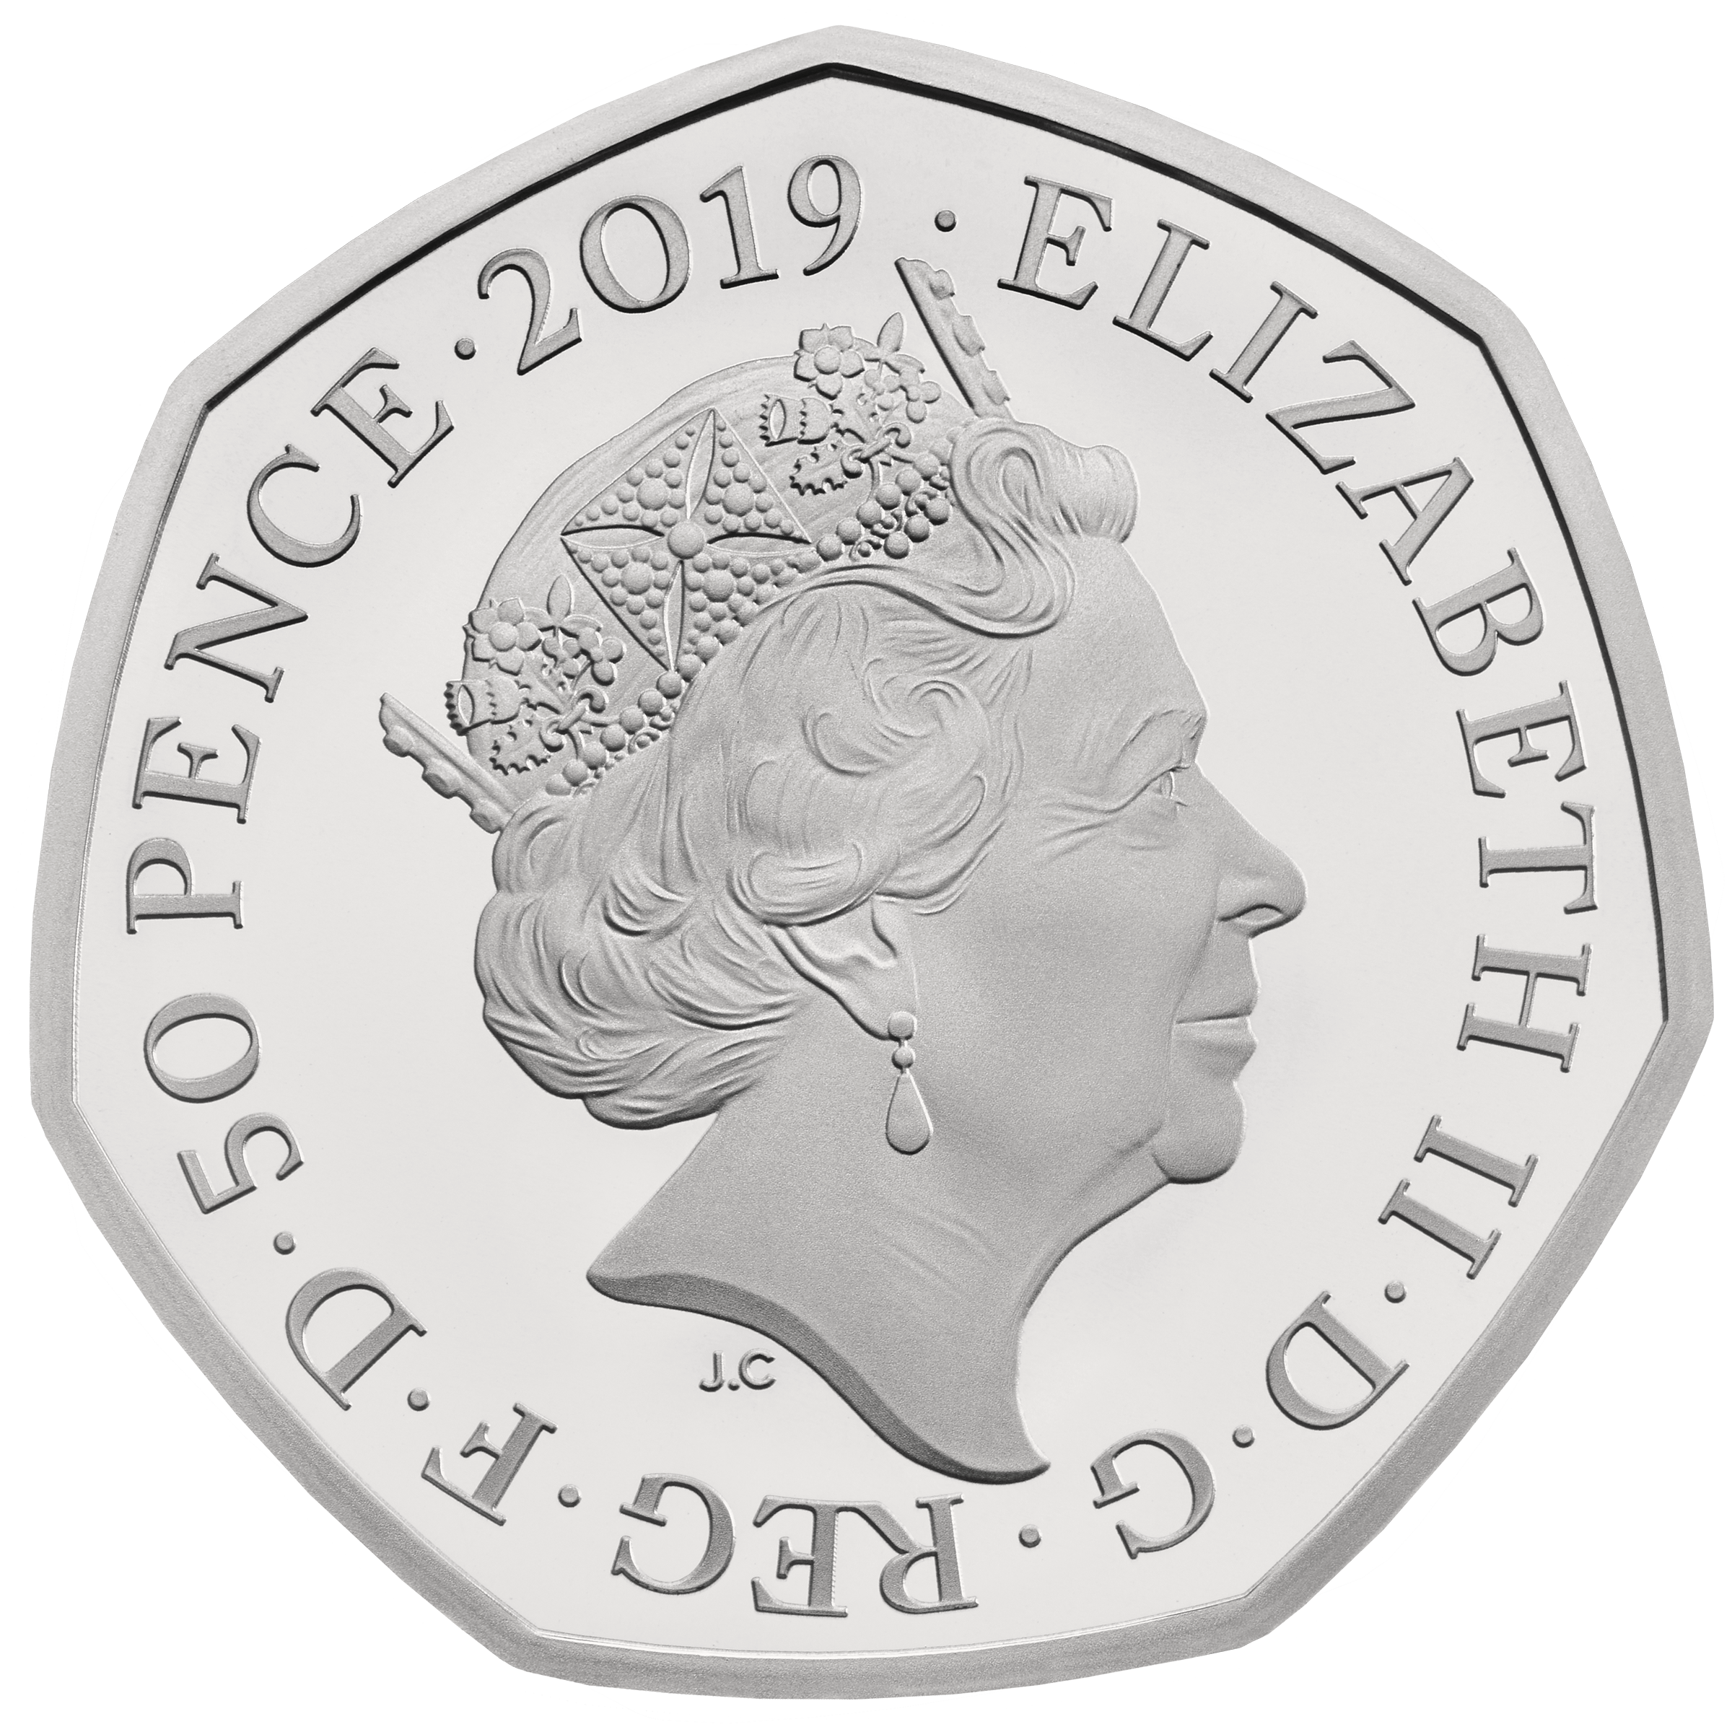
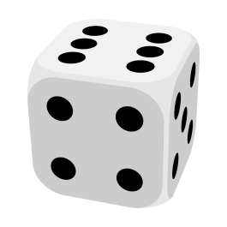
BASIC NOTATION
P is a probability
A is an event
P(A) = probability of event A occurring – a value between 0 and 1
P(A) = 0 – event A will never occur
P(A) = 1 – event A is certain to occur
P(A) = 0.5 – 50% chance that event A will occur
P(H) = 0.5
P(six) = 0.166667
Notes:
Now that we have a bit more understanding of what an event is, let’s look at some of the basic notation that we’ll use. The probability of an event A, denoted by P(A), is a real number (i.e., it has decimal values that can go on infinitely) between 0 and 1 that measures the likelihood of the event A happening.
A probability of 1 means that the event is certain to happen, and a probability of 0 means the event has no chance of happening.
The closer probability is to 0, less likely it is to happen.
Using this notation, we can say that the probability of tossing a coin and getting a Head is P(H) which is 0.5 (it has a 50% chance of happening if our coin is fair).
Similarly, the probability of rolling a six on our dice is 1 in 6, or 0.16667 (although typically we’ll round this to 2dp).

Slide 6
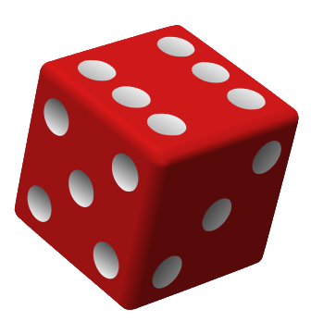




FINDING A PROBABILITY
RELATIVE FREQUENCY APPROXIMATION
P(A) = $\frac{number of times A occurred}{number of times a procedure was repeated}$
P(odd) = $\frac{|\left\{1,3,5\right\}|}{|\left\{1,2,3,4,5,6\right\}|}$
CLASSICAL APPROACH
= $\frac{3}{6}=0.5$
P(A) = $\frac{number of ways A can occur}{number of simple events in the sample space}$
SUBJECTIVE APPROACH
P(A) = an estimation/educated guess based on the circumstances
Notes:
To find the probability of event A occurring in a procedure, there are three different approaches.
The first (and perhaps most reliable of which) is called relative frequency approximation. We repeat the procedure loads of times and count how many times A occurred. Basically this is an observational method. Let’s say we had a biased coin. We toss the coin 1000 times and get tails 800 of those times. The probability of tails is then 800/1000, or 0.8.
For our purposes, we’re going to be using the classical approach to probability, where we assume that all simple events in our sample space are equally likely. For example, we assume that getting a Heads and a Tails will occur with equal likelihood (e.g., 50%) or that each of the 6 numbers on our dice will come up 1/6th of the time. As the example on the slide here, our event A is rolling an odd number. The number of ways that can occur is 3, and the number of simple events in the sample space is 6, therefore our probability is 3/6 = 0.5. Of course, this assumes that our dice isn’t loaded in some way.
An example of where we can’t use this is finding the probability that someone is a smoker. Our sample space is {smoker, non-smoker} but we can’t assume that 50% of people are smokers. We’d need to use RFA to get a more accurate result.
A subjective approach might be used when we just don’t have the necessary historical data. Like, what’s the probability of getting stuck in a lift? We don’t know for sure, but we might estimate that it’s around 1 in 10,000. Typically it’s best to avoid making guesses about probabilities, and we won’t be using that in this module.

Slide 7
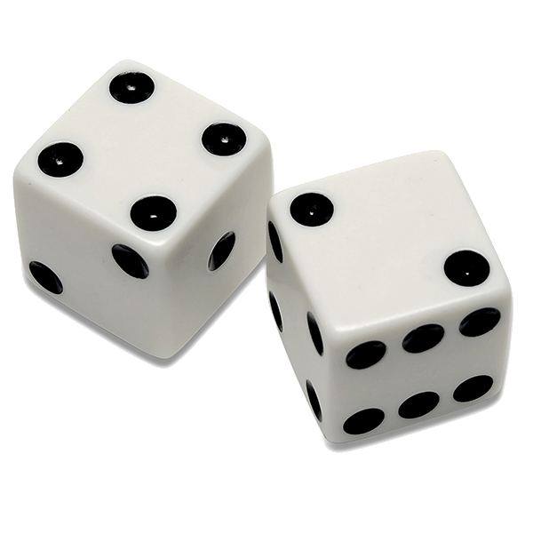



COMPLEMENT OF AN EVENT
The complement of event A, denoted by $\overline{A}$, consists of all outcomes in which event A does not occur
P(A) + P($\overline{A}$) = 1
P(A) = 1 – P($\overline{A}$)
$\overline{A}$ = {11,22,33,44,55,66}
P($\overline{A}$) = $\frac{6}{36}$ = 0.16667
P(A) = 1 – P($\overline{A}$) = 1 – 0.16667 = 0.83333
A = rolling two different numbers
Notes:
A simple but important concept is the complement of an event. The complement of event A, denoted by A with a line on top (which we call A bar), consists of all outcomes of a procedure in which A does not occur.
And the law of probability (and of the real world in general) states that the probability of event plus the probability of its complement is always one, which is kind of intuitively true. Either an event happened, or it didn’t happen. You can argue against this with quantum physics, but we’re not concerned with that in the macro-world we live in.
From simple maths and logic, another law is that probability of event A is one minus the probability of A-complement. And this is very important role because it simplifies calculating the probability of an event if it’s easier to calculate the probability of its complement. If an event is a bit complex to explicitly enumerate, we can consider a complement of that event.
As an example, suppose we’re rolling a 6-sided dice two times, and we want to find the probability of getting two different numbers. We could count all the different-number combinations, but it’d be much easier to count those combinations where we roll the same number twice (11,22,33,44,55,66). This is the complement of our event of interest, and by calculating its probability (6/36 or 1/6) we can use the rule above to calculate the probability of rolling two different numbers, which is 5/6 or 0.833.

Slide 8

UNION OF EVENTS
Union of events A and B, denoted by $A∪B$, consists of all outcomes in which event A occurred or event $B$occurred (or both occurred)
A = rolling the same number twice {11,22,33,44,55,66}
B = rolling at least a single 1 {11,12,13,14,15,16,21,31,41,51,61}
$A∪B$= {11,12,13,14,15,16,21,22,31,33,41,44,51,55,61,66}
Notes:
Finally, we're going to talk about constructing kind of compound events. The union of two events A and B is denoted by this U-shape which isn’t actually a U but is the ‘union operator’ in between them. A U B is all outcomes where event A occurs, event B occurs, or both of them occur. So let’s once again assume that we are rolling a six-sided dice twice and recording the results. Event A is that we get the same number twice, and event B is that we get at least a single 1. So we can get either a 1 on the first throw or a 1 on the second throw, or we get a 1 on both throws. So, if we look at the union of A and B, this is what we call a set union between these two sample spaces So A U B (we can also say A OR B) is the event where we either get two of the same number, or at least one of these numbers is 1. Notice that although 11 occurs in both A and B, it’s only counted once in A U B – we don’t repeat outcomes.

Slide 9
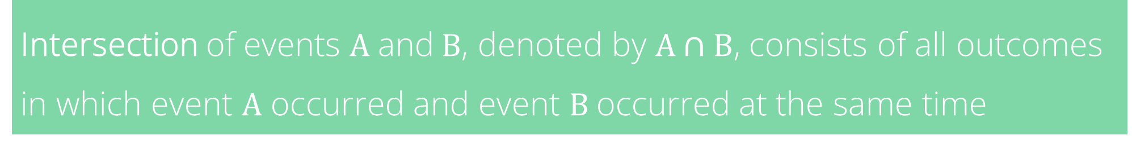
INTERSECTION OF EVENTS
Intersection of events A and B, denoted by $A∩B$, consists of all outcomes in which event A occurred and event $B$occurred at the same time
A = rolling the same number twice {11,22,33,44,55,66}
B = rolling at least a single 1 {11,12,13,14,15,16,21,31,41,51,61}
$A∩B$= {11}
Notes:
The intersection of two events A and B is denoted by this upside-down U symbol, which is the intersection operator. A $∩$ B consists of outcomes where both event A and event B occurred at the same time. Using the same example as we had before, the intersection of rolling the same number twice, and rolling at least a single 1, is the only outcome in which both of these events happens, which is 11. In terms of Boolean logic, you can think of A U B as ‘A or B’ and A $∩$ B as ‘A and B’.

Slide 10


THE ADDITION RULE
Given two events A and B, the probability of their union A ∪ B is:
P(A ∪ B) = P(A) + P(B) − P(A ∩ B)
Count the number of ways that A can occur, and the number of ways B can occur, but only count each outcome once
A = rolling a double {11,22,33,44,55,66}
B = rolling at least a single 1 {11,12,13,14,15,16,21,31,41,51,61}
P(A) = $\frac{6}{36}$ , P(B) = $\frac{11}{36}$ , P(A ∩ B) = $\frac{1}{36}$
P(A ∪ B) = $\frac{6}{36}$ + $\frac{11}{36}−\frac{1}{36}=\frac{16}{36}=0.444$
Notes:
This gives rise to one of the most important basic theorems of probability – the Addition Rule. Given two events A and B, the probability of their union is calculated by adding their individual probabilities together and subtracting the probability of their intersection.
Intuitively, to find the probability that either event A or B occurs, we count the number of ways that A can occur, and the number of ways B can occur, but we make sure that we count each outcome only once.
Let’s look at our dice example one last time. Assume that we are rolling a 6-sided dice twice. If event A is that we get the same number twice and event B is that we get at least one 1, we can find the probability of A U B as follows.
The probability of A occurring is 6/36, the probability of B occurring is 11/36, and the probability of their intersection (which is a single outcome) is therefore 1/36.
We simply add the two individual probabilities together, giving us 17/36 and subtract 1/36 (the intersection) to give us 16/36 or 0.444 as a real number.

Slide 11
DISJOINT EVENTS
Disjoint events cannot occur at the same time.
If A and B are disjoint, P(A ∪ B) = P(A) + P(B) − P(A ∩ B)
A = rolling a 1 first {11,12,13,14,15,16}
B = rolling a 5 first {51,52,53,54,55,56}
P($A∪B)=\frac{6}{36}+\frac{6}{36}=\frac{12}{36}=0.3333$
Notes:
Finally, we’ll look at the concept of disjoint events. Two events are disjoint if they cannot occur at the same time. In other words, two events are disjoint if their intersection is empty. This means that the addition rule for disjoint events is especially nice and easy. If the events A and B are disjoint, then the probability of their union is the probability of A plus the probability of B. We don’t need to worry about their intersection because this has a probability of 0.
As an example, suppose we are rolling a six-sided dice twice. We want to find the probability that the first number is 1 or the first number is 5. So we can calculate this easily. Again, our sample space is going to be set of all 36 dice rolls. Event A, that the first number is 1, is the set of outcomes illustrated. Event B is the set of outcomes illustrated, and both have a size of 6. We can see they are disjoint because there are no common simple events in these two sets. Obviously, when we roll our first dice, it can’t simultaneously be a 1 AND a 5. So the probability of A U B is simply the probability of A plus the probability of B, which is six divided by 36 plus six divided by 36, which is then 12 divided by 36, which is 0.33.
And that's about it for this video. You can find more examples in the Elementary Statistics book (Chapter 3, Sections 1-6). In the next video we're going to talk about conditional probability and look into some ways of counting the number of simple events in a sample space using formulas, when it’s difficult to do manually.

